Slide 1

ICT FINAL PROJECT
SITE-INVESTIGATION WEB APP
BY: MICHAEL BOLGER
20011937

Slide 2

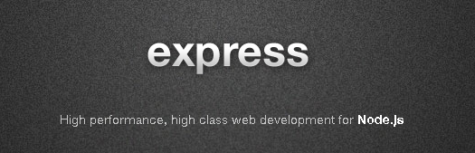
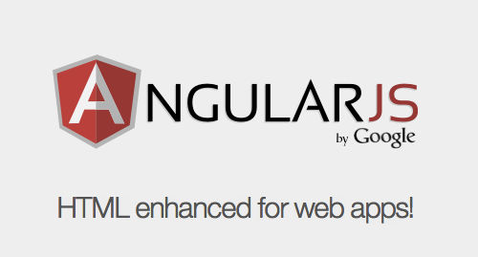

Overview
Site Investigation
Key Technologies
The MEAN stack
MongoDB
ExpressJS
AngularJS
NodeJS
Node Modules
webRTC
Bootstrap UI
Demo

Slide 3
Site Investigation
Site Characterization Form
Determining if a site is viable for on site drainage schemes such as septic tanks and percolation areas.
Traditionally done via pen and paper method and later transcribed to PDF.
Key Features of Site Investigation
Trial Holes
Percolation testing
P-Test
T-test
Recommendations

Slide 4


Key Technologies
Mongo DB
Mongo DB is a NoSQL database.
Uses binary JSON format called BSON to store content instead of a traditional table based SQL approach.
Used in this project for storing :
User Data
Site Characterization Data

Slide 5
Key Technologies
Express JS
“Express is a minimal and flexible Node.JS web application framework that provides a robust set of features for web and mobile applications”(express.js.com)
Web application framework used to help organize the app into a Model View Controller architecture.
Express.JS is used for
Routing
Handling Requests
Views

Slide 6
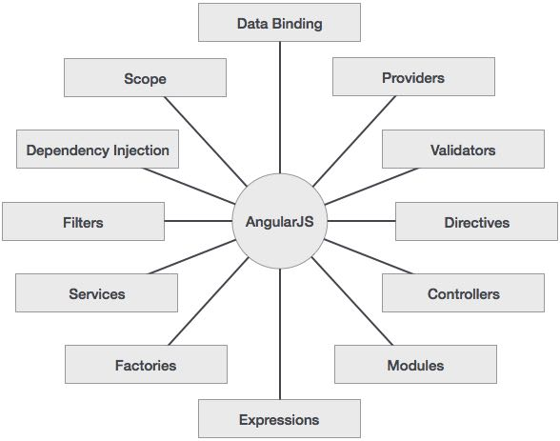
Key Technologies
Angular JS
Angular JS is a structural framework used in this project to extend HTMLs’ syntax.
Angular JS uses data-binding and to minimize the amount of coding within the project.
Angular JS Concepts

Slide 7
Key Technologies
Node JS
Node JS is an open source, cross platform runtime environment for server side networking applications.
Node uses event driven architecture and a non blocking model.
Node Package Manager (NPM) is used to manage dependencies within the app, allowing new features to be added.

Slide 8
Node Modules
Key Modules
Bcrypt
Used to encrypt password data
Body-parser
Used for express to read JSON on POST requests automatically
Gulp
Used as a build automation system for the project
jwt-simple
Used to create sessions via a JSON Web Token
mongoose
Used as a method to interact with mongoDB
Protractor
Used as a test runner
Mocha
Used as a testing framework to simulate user inputs

Slide 9

webRTC
API that supports browser-to-browser applications for voice calling, video chat and peer-to-peer file sharing without needing plugins.
Implemented as video chat feature to allow a conference between multiple users

Slide 10
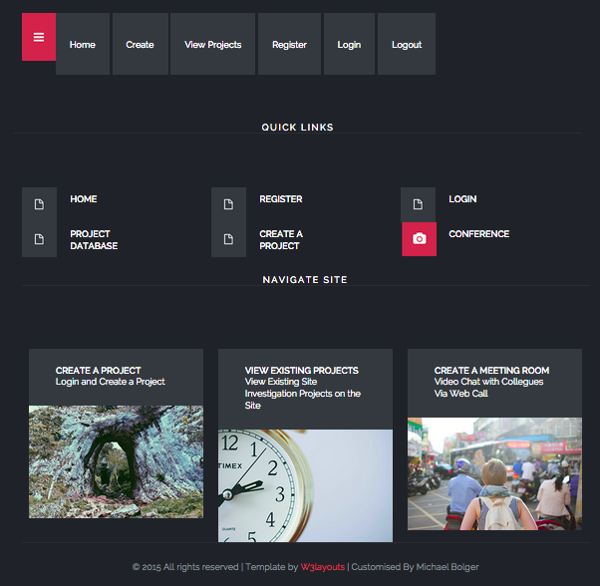
Bootstrap UI
Pre defined template customized for use in the project
Home Page

Slide 11
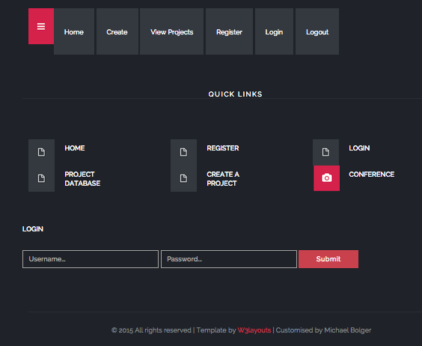
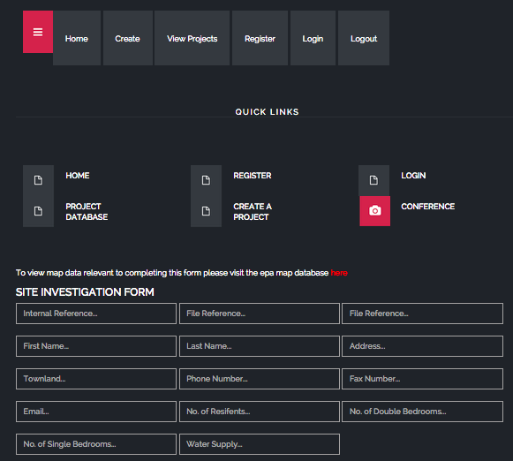
Bootstrap UI
Login Page
Create a Project Page

Slide 12
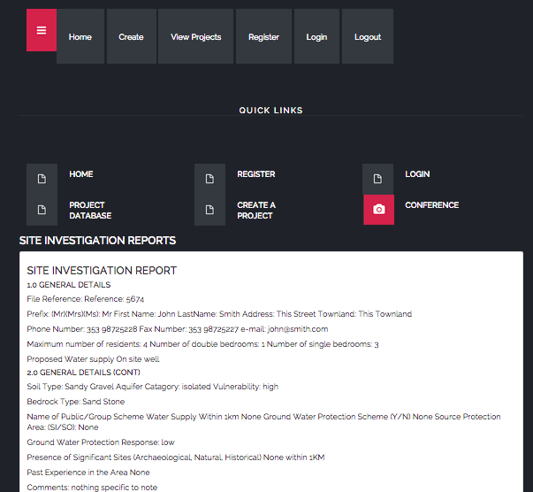
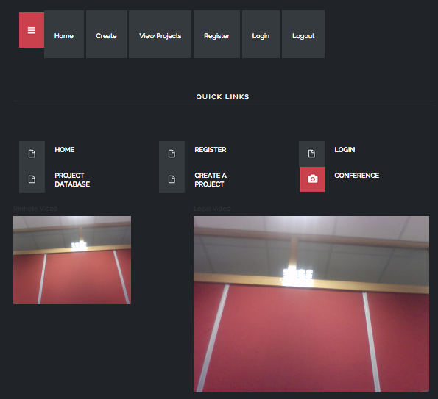
Bootstrap UI
Results Page
Conference Room

Slide 13

Questions

